Slide 1
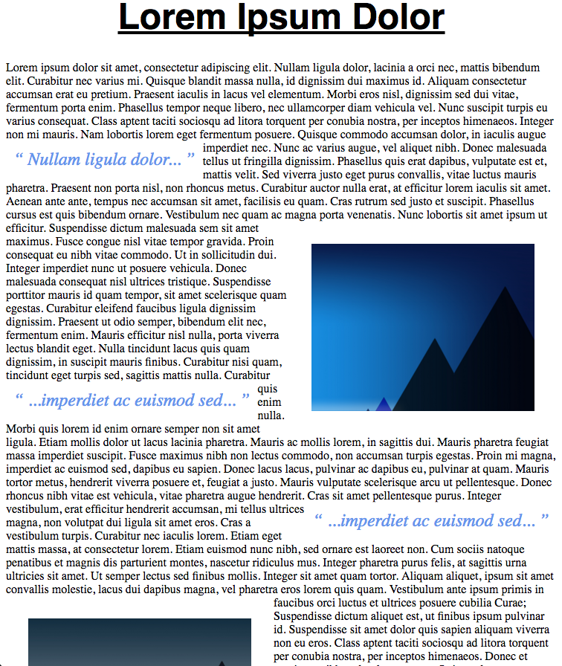
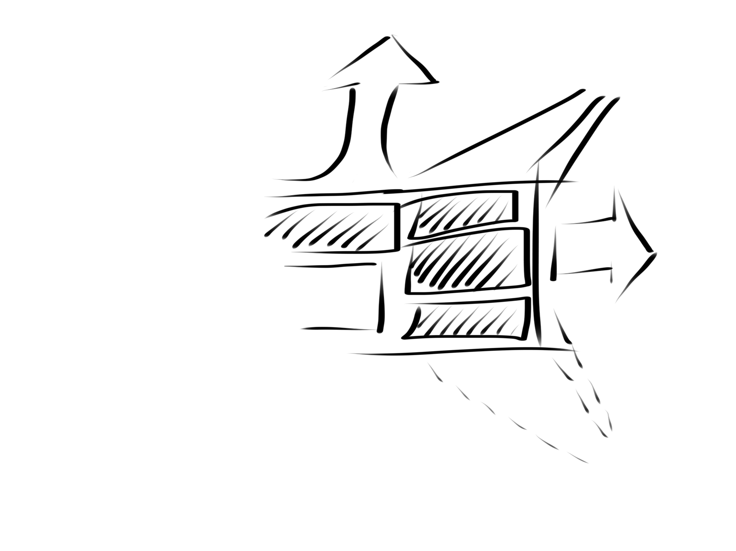
Web Design MCOSS2WED
Dynamic Design: float and clear

Slide 2
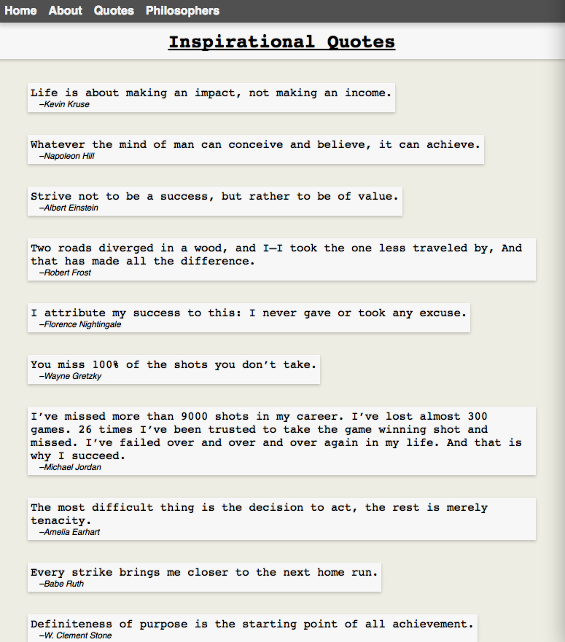
Previously…
We have looked at some HTML and CSS basics and created a web page. Mine looked like this:

Slide 3
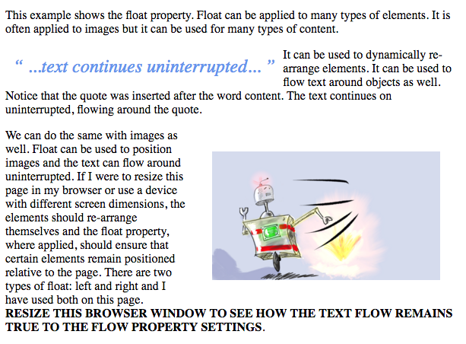
Previously…
We will now look at how the content on a page can shift and flow dynamically.

Slide 4
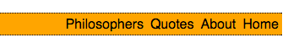
Float
When we created a navigation bar. We used the float:right property to shift the unordered list/menu to the right-hand side of the page.

Slide 5
Float
The float property is accessed as part of the styling (usually in a CSS file).
You can float an element left or right.
.image1 {
float: right;
}

Slide 6
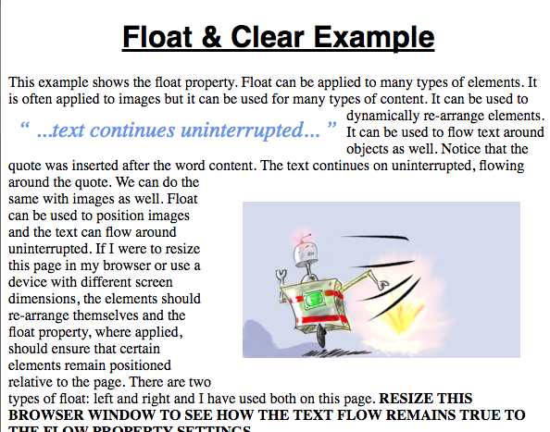
Float
This <q> element has a float:left property
This image has float:right set

Slide 7
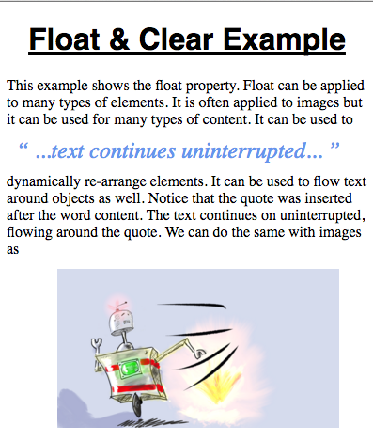
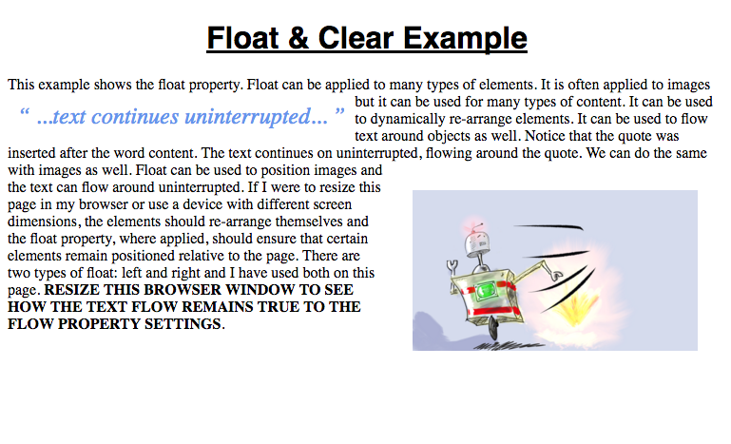
Float
As the web page is resized…
…the elements set to float move left and right towards the sides of the page…
…and the text flows around these elements in the space left behind.
See float-example1.
Float
Float

Slide 8
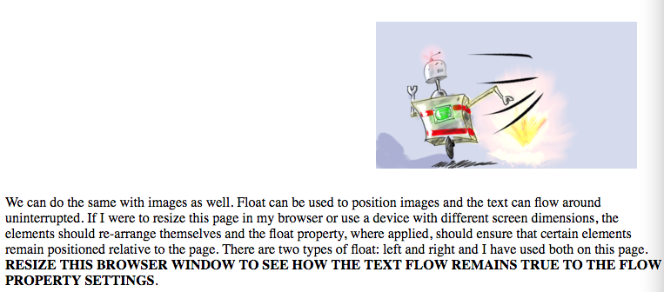
Clear
But if we wanted a paragraph of text (or any other element) to be displayed after a floating element (perhaps in a new section), we can use clear.

Slide 9
Clear
The floating elements will still float as expected but the elements that have the clear property will not flow around them.

Slide 10
Clear
The clear property can be set left, right or both in CSS like this:
.para1 {
clear: left;
}
.para2 {
clear: right;
}
.para3 {
clear: both;
}

Slide 11
Clear
Elements set to clear:left will not appear on the same line as the previous element set to float:left.
Elements set to clear:right will not appear on the same line as the previous element set to float:right.
Elements set to clear:both will not appear on the same line as a previous element set to float:left or float:right.
See float-example2 and 3.

Slide 12
Task 1
Recreate a magazine style web page (roughly A4 size) using float and clear.
The text and images can be random (try http://www.lipsum.com/ for random text).
See float-example4.

Slide 13
Task 2
Find out what “Bootstrap” is in relation to web design.
Who created it?
Why?

